Slide 1
Features Overview
PART 1/2
ACE Solutions Architecture Team

Slide 2
Agenda
Overview
Transit
Network Segmentation
Distributed Cloud Firewall
Secure Egress
High Performance Encryption

Slide 3
Overview

Slide 4
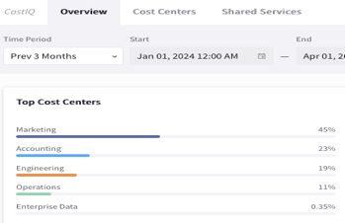
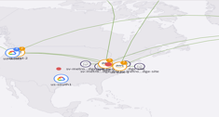
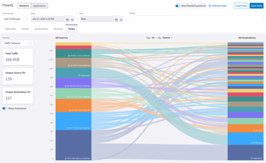

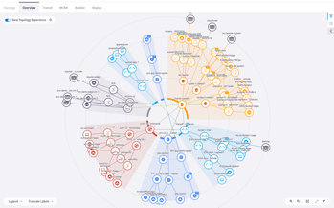

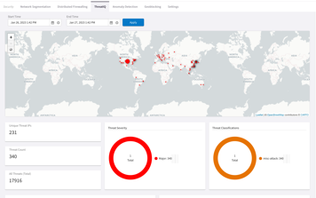


Aviatrix Cloud Network Platform Software
Single Multicloud Provider
Not a SaaS or
Managed Service.
It’s Yours.
Multicloud
Operational
Visibility
Centralized Automation, Orchestration and Control Plane
Aviatrix
Controller
4
1
Aviatrix
CoPilot
FlowIQ
Multicloud
Traffic Flow
Analysis
Centralized
Management Plane
2
Aviatrix Gateways
Cloud Fabric (Distributed Data Plane)
Multicloud
Dynamic
Topology
Mapping
Cloud Networking Abstraction
Native Cloud
Constructs
API
3
API
Basic Cloud
Network and Security
Service Insertion
and Chaining
ThreatIQ with
ThreatGuard
Distributed Threat
Visibility and
Control

Slide 5
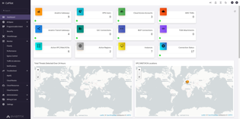
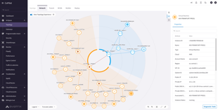
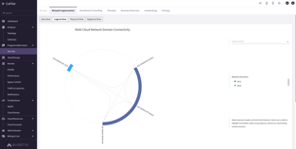
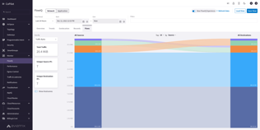




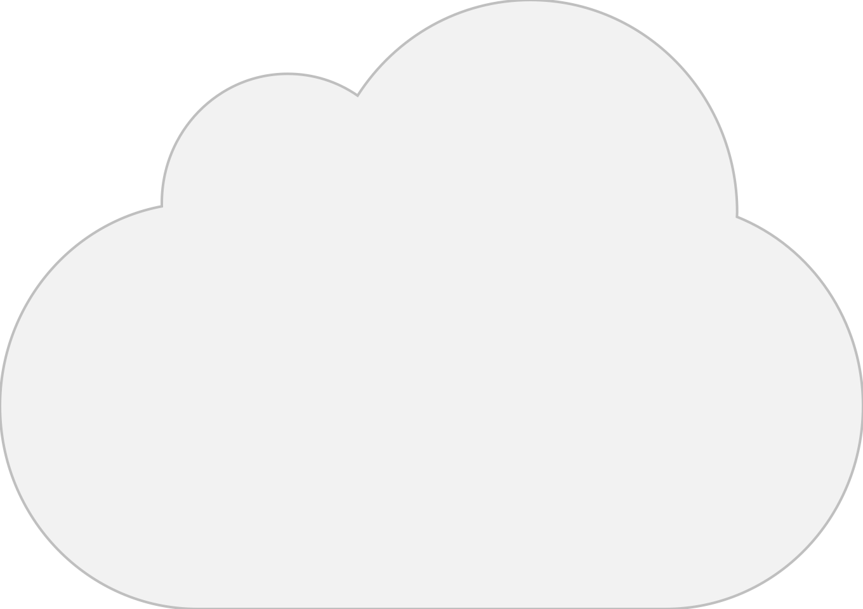





Aviatrix – Foundation of Multi-Cloud Networking and Security
Aviatrix
CoPilot
Aviatrix
Controller
Single Multicloud
Provider
7
10
VPC
VPC
VPC
VPC
VPC
VPC
VNET
VNET
VPC
VPC
VCN
VCN
11
5
1
Region 1
2
3
Region 2
4
6
8
9
INTERNET
1. Single Cloud
Multi-Account
High-Availability (Active-Active)
End-to-End Encryption
Network Correctness
2. Multi-Region
6. Service Insertion & Chaining
9. Secure Ingress and Egress
3. Multicloud Repeatable Design
7. Enterprise Operational Visibility
10. Cloud-Native
4. High-Performance Encryption
8. Secure Cloud Access
11. Distributed Cloud Firewall
5. Network Segmentation

Slide 6
Aviatrix Controller
Single Aviatrix Controller for all the clouds
Do not need to sign a separate licensing agreement with Aviatrix to get started
Controller can be launched from any cloud provider's Marketplace (Pay-As-You-Go/ metered: Best for PoC and single use case)
You can also use your Cloud Provider Credits (like AWS Marketplace credits)
Enterprise Agreement: Production deployment (most enterprises)
Notes:
Subscription is a must

Slide 7
Aviatrix CoPilot
Gain visibility and control over your cloud network with Aviatrix CoPilot
Topology
Interactive mapping and in-line troubleshooting for your cloud network
FlowIQ
Detailed Network Analysis and Flow inspection
AppIQ
End-to-End Application Path Inspection and Troubleshooting
ThreatIQ and ThreatGuard
Multicloud native network security to identify and block traffic to known malicious destinations
Network Behavior Analytics
Uses your specific network characteristics to construct a behavioral baseline
Identifies and alerts on potential threats through abnormal network behavior
Distributed Cloud Firewall
Granular network security controls for distributed applications in the cloud
Dynamic, embedded solution that creates zero-trust enforcement with centralized policy management across multiple clouds

Slide 8
Transit Networking
With Dynamic Routing and Traffic Engineering

Slide 9









Aviatrix Transit Network
APPLICATIONS LAYER
SECURETY
LAYER
Spoke VPC 1
Spoke VPC 2
Spoke VNet 1
Spoke VNet 2
Spoke VPC 1
Spoke VPC 2
Transit VNet
TRANSIT CORE
BACKBONE LAYER
Transit VPC
Transit VPC
OPERATIONS LAYER
ACCESS LAYER
BRANCH
OFFICES
ON-PREM
DATA CENTER
Vendors/Partners
REMOTE
USER
INTERNET
IoT
Azure
GCP

Slide 10
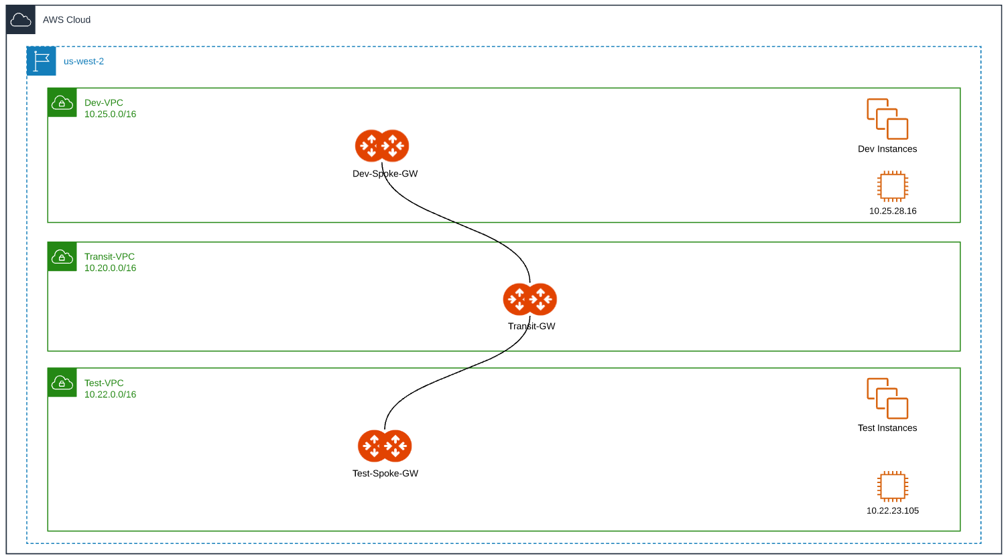
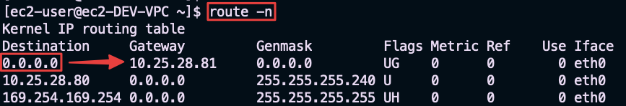
Packet Walk
Dev-VPC route table (underlay)
Destination | Target
10.0.0.0/8 | ENI of Dev-Spoke-GW
1
Src IP = 10.25.28.16 | Dst IP = 10.22.23.105
Private IP: 10.25.81.91 Public IP: 52.88.117.172
Dev-Spoke-GW route table (overlay)
Destination | Target
10.22.0.0/16 | Encap to 35.155.31.81 (Transit-GW)
Outer Src IP = 52.88.117.172 | Outer Dst IP = 35.155.31.81
Inner Src IP = 10.25.28.16 | Inner Dst IP = 10.22.23.105
Encap
2
Aviatrix Transit-GW route table
Internal decap
3
Destination | Target
10.22.0.0/16 | Encap to 54.184.119.18 (Test-Spoke-GW)
Public IP: 35.155.31.81
Outer Src IP = 35.155.31.81 | Outer Dst IP = 54.184.119.18
Inner Src IP = 10.25.28.16 | Inner Dst IP = 10.22.23.105
4
Encap
Test-Spoke-GW route table
Src IP = 10.25.28.16 | Dst IP = 10.22.23.105
Decap
5
Destination | Target
10.22.0.0/16 | Decap to eth0 (VPC underlay)
Test-VPC route table
Private IP: 10.22.80.154
Public IP: 54.184.119.18
Destination | Target
10.22.0.0/16 | Local
9

Slide 11
Network Segmentation

Slide 12
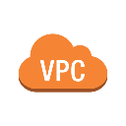

MCNA Deployment: the Foundations
APPLICATIONS LAYER
CORE
LAYER
Spoke VPC 1
Spoke VPC 2
Spoke VNet 1
Spoke VNet 2
Spoke VPC 1
Spoke VPC 2
TRANSIT LAYER
Transit VNet
Transit VPC
Transit VPC
OPERATIONS
ACCESS LAYER
BRANCH
OFFICES
ON-PREM
DATA CENTER
Vendors/Partners
REMOTE
USER
INTERNET
IoT
AWS
Azure
GCP

Slide 13
Global Segmentation with Network Domains
APPLICATIONS LAYER
CORE
LAYER
Spoke VPC 1
Spoke VPC 2
Spoke VNet 1
Spoke VNet 2
Spoke VPC 1
Spoke VPC 2
Transit VNet
TRANSIT LAYER
Transit VPC
Transit VPC
OPERATIONS
ACCESS LAYER
BRANCH
OFFICES
ON-PREM
DATA CENTER
Vendors/Partners
REMOTE
USER
INTERNET
IoT
AWS
Azure
GCP

Slide 14





Multicloud Network Segmentation
Aviatrix
CoPilot
Policy Based Network Segmentation
Global
Consistent / Repeatable
Across accounts, subscriptions & projects
Cloud and Connection Agnostic
Single cloud
Intra-region or inter-region
Multiple clouds
Edge/Access Segmentation
On-Prem DCs
Branches
Extranets
Cloud Peering
On-Demand Compliance/Governance
Security Posture within minutes
Aviatrix control plane realizes the intent
Zero-Trust
Flexible
Automated
Blue Segment
Green Segment
Connection Policy
VPC
SS
VPC
VPC
VPC
VPC
VPC
VPC
VPC
VPC
VNet
VNet
VNet
Transit
VPC
FireNet
Transit
VPC
Transit
VPC
FireNet
Transit
VPC
Transit
VNet
FireNet
IT
BU1
BU2
IT
AWS - REGION1
GCP – REGION1
GCP – REGION2
AZURE - REGION1
DirectConnect
Site2Cloud
Site2Cloud
Express Route
Extranet
Extranet
BRANCH OFFICES
Data Center
Data Center
Notes:
We can have production environments, dev environments completely segregated using that common networking backbone, the transit core network that we saw before

Slide 15
Distributed Cloud Firewall
Aviatrix DCF

Slide 16




Aviatrix DCF Centrally Managed, with Distributed Inspection & Enforcement…
Internet
Internet
Internet
Internet
Internet
Internet

Slide 17






And, What If it was more than just firewalling…
Internet
Internet
Internet
Distributed
Firewalling
Internet
IDS / IPS
SG
Micro-Segmentation
Advanced NAT
Threat Prevention
Internet
Decryption
URL
Filtering
Internet

Slide 18
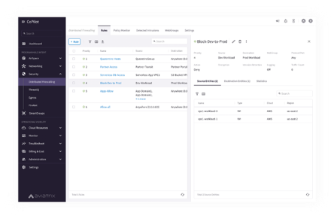



A Distributed Cloud Firewall…
Where and How Policies Are Enforced Is Abstracted…

Slide 19
Distributed Secure Egress

Slide 20













Problem Statement
Private workloads need internet access
SaaS integration
Patching
Updates
NAT Gateway
Squid Proxy
Layer-7 Firewall
Layer-4 only
NACLs management
Hard to manage
Scale and HA issues
Overkill
Expensive
VPC
VPC
VPC
Internet gateway
Internet gateway
Internet gateway
Public subnet
Public subnet
Public subnet
NAT gateway
Firewall
Squid Proxy
Private subnet
Private subnet
Private subnet
Workloads
Workloads
Workloads
Notes:
The private workloads need to access internet for several reasons: for SaaS integration, for patching, for software updates, for version control systems.
On AWS the cloud native that is offered by the CSP is of course the NAT gateway.
This solution only allows the traffic that is generated from the private subnets, thus, if you want to control what nodes can be reach from the workloads inside the private subnets, you can configure the NACL accordingly. However, with a NACL you can only filter based on the IPs and not on the domain names.
The alternate solution to control the traffic going out to Internet from a private subnet is to deploy a SQUID proxy, but this is a black-box and is difficult to manage. Another solution is to deploy a NGFW, but might be too much expensive and can be cumbersome

Slide 21




Aviatrix Secure Egress Filtering Feature
Internet
VPC
VPC
VNet

Slide 22


Aviatrix Secure Egress Filtering
Aviatrix
CoPilot
Activate the Egress
on the required VPCs/VNets
Internet
Centralized
Management
Aviatrix
Spoke Gateway
Aviatrix
Spoke Gateway
Aviatrix
Spoke Gateway
VPC
VPC
VNet
Distributed
Control
Distributed
Control
Distributed
Control

Slide 23
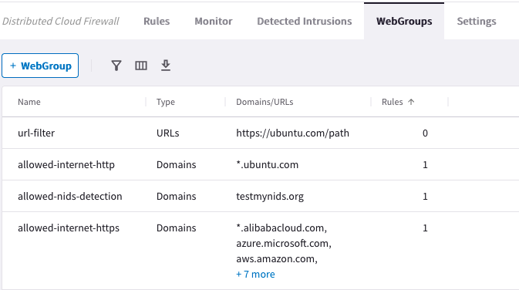

Aviatrix Secure Egress Filtering
Aviatrix
CoPilot
Internet
Centralized
Management
Egress Filtering
Policies with WebGroups
Domain Filter
Domain Filter
Domain Filter
*.github.com
updates.ubuntu.com
api.twillio.com
deny all
*.github.com
updates.ubuntu.com
api.saas.com
deny all
*.github.com
updates.ubuntu.com
api.google.com
deny all
Aviatrix
Spoke Gateway
Aviatrix
Spoke Gateway
Aviatrix
Spoke Gateway
VPC
VPC
VNet
Distributed
Control
Distributed
Control
Distributed
Control

Slide 24
Aviatrix Secure Egress Filtering
Aviatrix
CoPilot
Internet
Centralized
Management
Egress Filtering
Policies with WebGroups
Domain Filter
Domain Filter
Domain Filter
*.github.com
updates.ubuntu.com
api.twillio.com
deny all
*.github.com
updates.ubuntu.com
api.saas.com
deny all
*.github.com
updates.ubuntu.com
api.google.com
deny all
Aviatrix
Spoke Gateway
Aviatrix
Spoke Gateway
Aviatrix
Spoke Gateway
VPC
VPC
VNet
Distributed
Control
Filtered
Distributed
Control
Filtered
Distributed
Control
Filtered

Slide 25



Aviatrix Secure Egress Design Patterns
Stand-alone Spoke GW (Distributed)
Local Egress (Distributed)
with Aviatrix Spoke GW
Centralized Egress
with Aviatrix Transit GW
Egress on Spoke
Stand-alone Spoke Gateways
VPC
VPC
VPC
VPC
VPC
VPC
Spoke Gateways
Spoke Gateways
Spoke Gateways
Spoke Gateways
Transit VPC
Transit VPC
Transit Gateways
Transit Gateways
Egress on Transit

Slide 26
High Performance Encryption (HPE)
aka Insane Mode

Slide 27




Zero Trust – Datapath Encryption
UNTRUSTED
Datapath Encryption = NO
Application Encryption = Maybe
Aviatrix Datapath Encryption
Public
Cloud
Azure Express Route
Aviatrix Datapath Encryption
UNTRUSTED
AWS Direct Connect
Data Center
TRUSTED LAN
Notes:
What are the different use cases where we can enable HPE? The main use case, is when the customer is connecting its own on-prem DC to any CSP.
As you are aware with the different areas, there are some areas that you trust and some areas that you do not trust.
Usually when I am working with a device with whom I do not have a complete control, in other words I am not the admin of the device and I do not know who is accessing that device in addition to me, this is a perfect candidate to be regarded as an UNTRUSTED AREA.
What happens inside my DC is for sure regarded a TRUSTED AREA: I am the admin, I am the owner of the whole infrastructures, and I know who has been granted access to.
Conversely, When I connect the DC to the Public Cloud,using an AWS Direct Connect or an Azure Express Route, The connection will span a provider’s infrastructure, MegaPort or Equinix and then from there, the connection will lend on the Public cloud.
To wrap up, I am going to use resources from both the provider that is offering the private link and then I will start using resources that are inside the cloud service provider: both these areas should be considered as UNTRUSTED areas.
Although both equinix and the csp can claim that they are securing my connection very well, and I am sure they do it, but at the end of the day the compliance of the security as a customer ultimately I am responsible for, I want to have the best of security of my “data in flight”. So, what Aviatrix provides is Datapath encryption, end-to-end, from the DC to the csp, spanning the provider of the private link.
You can also establish a secure datapath encrypted within the cloud or between multiple clouds.
By default, all the aviatrix gateways establish IPSec tunnels among themselves

Slide 28
Problem Statement – Native Cloud IPsec Performance is Limited
Native Cloud IPsec VPN solutions have a maximum encryption performance of 1.25Gbps per tunnel
VPC ←→ VPC
On-prem ←→ Cloud (including DX – but link could be 10G!)
Cloud ←→ Cloud
That’s because virtual routers utilize a single core, and they establish only one tunnel
Tunnel
Notes:
So, what is the issue natively with the csp IPSec tunnels? As you might know, IPSec is highly intense in terms of connections setup, packet encryption/decryption (encryption algorithm), authentication algorithm, the rekeying process.
The sort of limitation that exists in the CSP is that the IPSec tunnel cannot exceed 1.25Gbps of throughput., and this is because in the cloud the VMs are based on x86 architecture, and when you try to establish an Ipsec tunnel between your router inside the DC and on instance spinned up in the cloud, the end of the tunnel (in this case the x86 instance) will dictate the maximum throughput that can be reached, even though on your side you have a powerful Fortinet firewall or router.
With x86 instances, when you build up an IPSec tunnel, the connection is generated using a single vCPU core.
In the drawing is depicted this specific case: we have on the left our vpn gateway, for instance a fortinet fw, and on the right we have a virtual machine (based on x86 architecture), for instance an aws TGW, and the tunnel will not go above 1.25Gbps.
We are not using the full capability of the x86 instance, but in addition to this, if you are running the IPSec tunnel on top of a private link that is capable to sustain for instance 10Gbps of throughout, you are also underutilizing that link, because you are paying a lot of money, but you are using almost 10% of the entire throughput: in a nutshell you are limited to a bad performance, because of this limitation.
Do you know why the CSP is limiting the IPSec tunnel to only reacing 1.25gbps? Because all software-based IPSec vpn solutions have maximum performance of 2Gbps depending on the ciphers that is used.
Probably this will be improved in the future, but we have to wait for this enhancement.
To wrap up, the traffic that you generate from your DC directed towards the public cloud can only use single core, despite availability of multiple cores…

Slide 29
Solution: Aviatrix High Performance Encryption (HPE)
Aviatrix Controller automatically builds multiple tunnels between Aviatrix devices
Uses all available CPU cores
IPsec encryption performance can be up to 90 Gbps
High Performance Encryption
Aviatrix
Transit or
Spoke GW
Aviatrix
Transit or
Spoke GW
UDP/ESP
High Performance N x Tunnels
vCPU
vCPU
Up to 90 Gbps
vCPU
vCPU
Encryption/Decryption
Encryption/Decryption
Aviatrix
Edge
vCPU
vCPU
vCPU
vCPU
Aviatrix
Transit GW
Notes:
Aviatrix, out of the box, allows you to activate in addition to the traditional IPSec tunnel, the High Performance encryption that is also called “insane mode”.
This is a proprietary cutting-edge technology that allows to use, of course on the aviatrix gateways, all the possible available vCPU cores.
On the left side you have an aviatrix gw, likewise on the right, and for sake of simplicity each GW has 4 vCPU cores, and HPE turns out allowing to use all cores, aggregating them, bundling them.
You can benefit from all the available cores: each IPSec tunnel is established between a core running on the left gateway and another core running on the GW on the right.
HPE of course, can be activated only if you have aviatrix gateways on both sides.
There are different scenarios where you can activate HPE:
1) Between gateways running within the CSP, such as between Spoke and Transit Gateways
2) Between Transit Gateways and Transit Gateways
3) Between Transit Gateway and your on-prem DC, if you install and run the Aviatrix Edge device running on top of vmware
Just to summarize, as you can see depicted in the drawing, with all these tunnels aggregated you can achieve 90Gbps in AWS, but what does this 90Gbps really mean? It means the total amount of the throughput. You achieve a logical pipe

Slide 30
Next: Platform Overview part.2

Slide 31



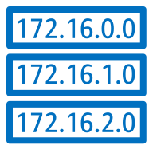
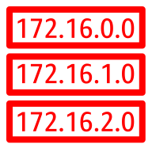
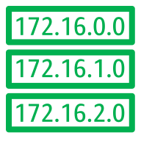
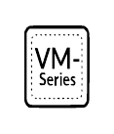
Distributed Firewalling (with Micro-segmentation)
VNET
VPC-2
VPC-3
VPC-4
Network Domain | Connects To
Prod | Shared Svcs
Dev | Shared Svcs
Shared Svcs | Prod, Dev
NGFWs can be a solution however an overkill for L3/L4 Rules & traffic has to be carried a long way to be inspected by the FW.
Distributed Firewall works by:
1.Leveraging the Aviatrix Spoke Gateways as Enforcement points.
2. Orchestate the provisioning of Azure NSGs, for Intra-VPC segmentation
A
E
B
C
D
Firewall also doesn’t have visibility and thus can’t affect intra-VPC traffic
Network Domains (a.k.a. VRFs)
Dev Prod Shared Svcs
The granularity of a Connection policy is at the Network Domain level thus it is not possible to:
Limit communication within the Network Domain (A to D)
Limit communication within the scope of the connection policy (A to C)
Diagram shows a single instance however in reality many instances will exist within each VPC.

Slide 32



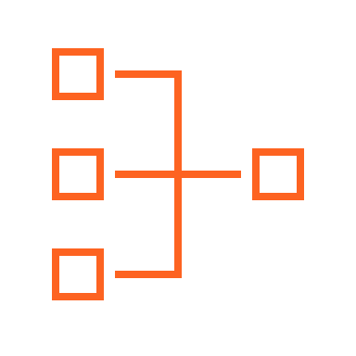

Distributed Firewalling
Network Domains
Smart Groups
VPC
VPC
VNet
VNet
WEB
DB
Apache
Nginx
VPC
VPC
VNet
VNet
A rule between SGs can be defined for achieving the INTER-SMARTGROUP communication
Region 1
Region 2
Region 1
Region 2
Network Segmentation and Distributed Firewalling are NOT mutually exclusive
A distributed firewalling rule can be defined in each Smart Group, for establishing what kind of traffic is allowed/denied among all the instances that belong to that Smart Group.

